Slide 1
Linear Regression
It is used to estimate real values (cost of houses, number of calls, total sales etc.) based on continuous variable(s). Here, we establish relationship between independent and dependent variables by fitting a best line. This best fit line is known as regression line and represented by a linear equation
Note : These coefficients a and b are derived based on minimizing the sum of squared difference of distance between data points and regression line.
Reference : Code Basics & https://www.mathsisfun.com/equation_of_line.html

Slide 2
How do you find "m" and "b"?
b is easy: just see where the line crosses the Y axis.
m (the Slope) needs some calculation:
m = change in Y / change in X

Slide 3
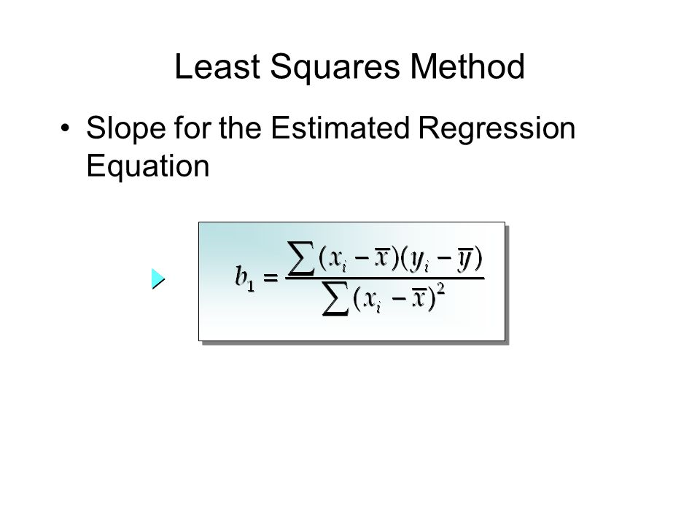
How do we create this line of best fit?
The most common method of creating this line of best fit is by using an estimation technique called the least square method. The equation is shown below where xi and yi is a specific value in your data set and x and y with a dash above is the mean for all the x or y values.
The equation for the least square method

Slide 4
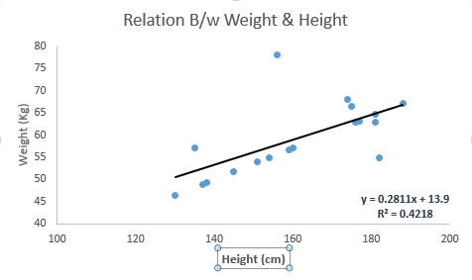
Look at the below example. Here we have identified the best fit line having linear equation y=0.2811x+13.9. Now using this equation, we can find the weight, knowing the height of a person.
Linear Regression is mainly of two types: Simple Linear Regression and Multiple Linear Regression

